Slide 1
“When I Look at You, I Don’t See Color,” Is Not A Compliment: How Microaggression Disrupts the Educational Environment
John Jay Faculty Development Day, January 2019
Wendy M. Nicholson, MPA
Adjunct Professor
John Jay College of Criminal Justice

Slide 2
Rules of Engagement
RULE 1: Be respectful at all times
RULE 2: Be open-minded
RULE 3: Refer to RULE 1

Slide 3
Learning Objectives
Understanding the theoretical framework of racism from a Critical Race Theory perspective
What are microaggressions?
Understanding the impact of microaggressions
Strategies for disrupting microaggression

Slide 4
Critical Race Theory
Racism is ordinary
Interest convergence (materialism determinism)
Social construction thesis
Different racialization and its many consequences
Each race has its own origins and ever-evolving history
Voice-of-color thesis
Delgado, R., & Stefancic, J. (2001). Critical Race Theory: An Introduction. New York New York University Press;

Slide 5
“Racial microaggressions are brief and commonplace daily verbal, behavioral, or environmental indignities, whether intentional or unintentional, that communicate hostile, de- rogatory, or negative racial slights and insults toward people of color.” (p. 271)
Sue, D.W., et al (2007). Racial Microaggressions in Everyday Life: Implications for Clinical Practice. American Psychologist, 62(4), 271-286.

Slide 6
Why is your hair like that?
You are so well spoken!
Your family members aren’t terrorists, are they?
You are smart for someone who lives in the projects! What’s it like?
Examples of microaggression

Slide 7
Forms of Microaggression
Microassault
An explicit racial derogation characterized primarily by a verbal or nonverbal attack meant to hurt the intended victim through name-calling, avoidant behavior, or purposeful discriminatory actions.
Ex. Displaying a noose or swastika; calling someone ‘China man’
Microinsult
Is characterized by communications that convey rudeness and insensitivity and demean a person’s racial heritage or identity.
Ex. “This job requires a doctorate, how did you get it?”
Sue, D.W., et al (2007). Racial Microaggressions in Everyday Life: Implications for Clinical Practice. American Psychologist, 62(4), 271-286.

Slide 8
Forms of Microaggression cont’d
Microinvalidation
Is characterized by communications that exclude, negate, or nullify the psychological thoughts, feelings, or experiential reality of a person of color.
Ex. When a person of color conveys a microaggressive incident to a white person, and is told to stop being so sensitive
Sue, D.W., et al (2007). Racial Microaggressions in Everyday Life: Implications for Clinical Practice. American Psychologist, 62(4), 271-286.

Slide 9
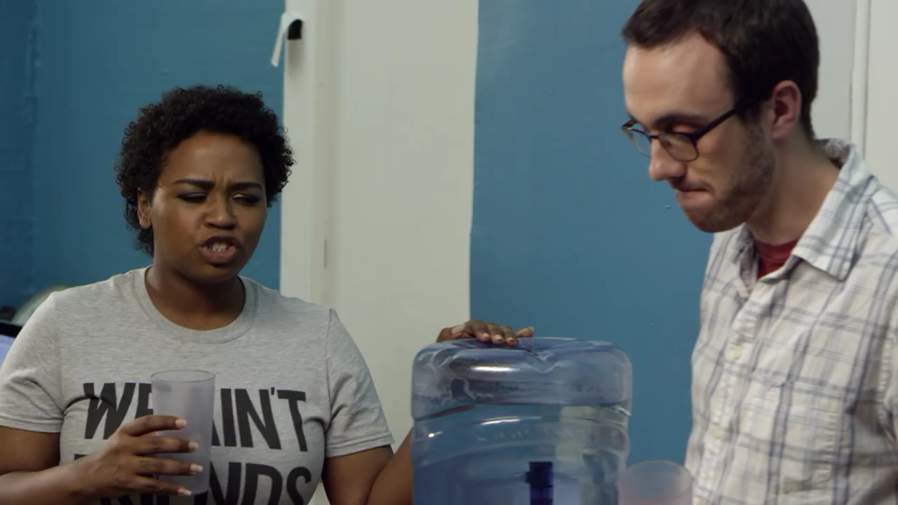

Slide 10
Impacts of Microaggression
Challenges with recruitment, retention, and attrition of faculty, staff, and students of color
Decreased/lack of job satisfaction
Decreased professional and/or academic productivity
Lack of institutional diversity and inclusion
Anger/resentment
Psychological trauma
Feelings of worthlessness
Feelings of powerlessness/futility
Increased stress
Avoidance/isolation
Resiliency

Slide 11
Group Activity
(20 minutes)
Write 1-3 experiences you’ve had with microaggression (victim, witness, perpetrator)
Discuss the impact it had on you (if applicable)
Develop strategies to address microaggression
Choose one member to report

Slide 12
Individual Strategies
Ignore incident/choosing when (or if) to confront issue
Seek support of friends, family, and/or co-workers
Avoid people, places, and spaces where behavior has/is likely to occur
Mentoring by colleagues of color
Psychotherapy

Slide 13
Disruption Strategies
The institution must recognize that microaggression exists and persists within its halls
Develop policies to, and publicly address the issue and mete out consequences for those found to engage in microaggressive behavior
Provide campus-wide implicit bias + inclusion training
Imbed microaggression training in cross-disciplinary curriculums and as part of faculty/staff eval requirements
Speak up and name a microaggression observed/witnessed as a bystander
Confront the aggressor
Educate by engaging in conversation
Don’t keep quiet
File a complaint with the Diversity Officer
Create faculty/staff, and students of color organization to foster support and mentorship
Genuinely apologize
Adapted from “The Campus and Beyond: Microaggressions and Strategies to Respond
Identify, Define, Share”. LaGuardia Community College, November 28, 2018; Louis et al (2016). Listening to Our Voices: Experiences of Black Faculty at Predominantly White Research Universities With Microaggression Journal of Black Studies, 7

Slide 14
Takeaway
Whether unconscious or unintentional, microaggression is still hurtful and damaging
Microagressive behavior is not okay, nor is it acceptable
We are ALL responsible to address, amend, and end microaggression

Slide 15
YOUR Action Plan
Continue to learn about microaggression and its impacts
Be aware of your words and actions, and those of others around you
Educate others
Be a disruptor

Slide 16
Wendy M. Nicholson, MPA
Adjunct Professor
wnicholson@jjay.cuny.edu
929. 390.1422

